Slide 1
SpaDES: Spatial Discrete Event Simulation
R package for powerful, fast, scalable simulation
Alex M. Chubaty
Eliot J. B. McIntire

Slide 2
Forecasting
We need to forecast the past, present and future of ecosystem properties
We need to either understand these systems, or at least come up with phenomenological relationships
We have (or will get data), whose magnitude is growing fast (“Big Data”)

Slide 3

R
R is the most comprehensive and powerful language for understanding and predicting from data
6079 packages
33 “taskviews”
http://cran.r-project.org/web/views/
E.g., MetaAnalysis, Optimization, Phylogenetics
Notes:
What is the number one system for understanding data?

Slide 4
Why R?
1/3
Free, open source, cross-platform
Tight link between simulation and data analyses (allows for optimization)
Very good for GIS and spatial analyses

Slide 5
Why R?
2/3
Highly flexible and scalable
Fast, performant code execution
Huge user support and help community

Slide 6
Why R?
3/3
High level delivery:
Building static and dynamic reports
Including interactive websites
Visualization is very mature
Can package standalone executables
e.g., for Windows end-users

Slide 7
Three levels of user in applied ecological sciences
Clients
Polished deliverable
E.g., government, industry, etc.
Scientists
Understand data
Create new questions
More or less skilled at coding
More power at fingertips = more questions can ask
Developers
E.g., computer programmer, off-the-shelf software

Slide 8
R as the unifier
R addresses all of these user levels:
Polished, professional, publishable reporting and visualization tools
Scientists gain access to low-level power through high-level functions
Fast development time for programmers

Slide 9
The SpaDES package for R
Spatial Discrete Event Simulation
Integrate modules that have a concept of time
Events are scheduled based when they occur/end
Goal: to integrate existing and not yet built simulation modules to ask new policy questions?

Slide 10
Integrated questions require integrated solutions
Given that spruce budworm is rampant, what are the forecasts for central Quebec in 10 years for:
Caribou?
Jobs?
Carbon?
Etc.
This can’t be answered by a single group
Need to join the caribou, economic, fire, climate, and carbon modules to the spruce budworm module.
Notes:
We can’t build a massive model of everything – and we don’t want to! Our goal is to integrate expert-built models in a common platform.

Slide 11
Integrated modelling approach
Evaluate models as hypotheses
Estimate uncertainty
Ensemble forecast modelling
Study cumulative effects
Feedbacks and interactions between modules

Slide 12
SpaDES: objectives and motivations
1/2
Rapid model development for wide variety of model types (IBMs, matrix, etc.)
Faster, more memory efficient, more scalable, than current systems (e.g., NetLogo, SELES, Repast, etc.)
Capitalize on R’s strengths as a data manipulation and data analysis platform
Notes:
Simulation models are essentially data manipulation combined with data analysis.

Slide 13
SpaDES: objectives and motivations
2/2
Be open source and make it easy to contribute modules and code
Be easy to use for scientists who aren’t formally trained as programmers
Allow tight coupling of models and data
Built around modularity so that models can be seen as modules that are easily replaceable (not just “in theory”)

Slide 14
SpaDES: design overview
agents
simulation
parameters
modules
data
maps
data
maps
variables
“internal”
module
schedule
event
model
“external”
module
event queue
file
outputs
timer
screen
outputs
process event

Slide 15
SpaDES: module overview
Description of all possible module events:
Event type (e.g., init, move, plot)
What happens during processing the event
Modules can be user-modified or user-built
Minimize module interdependencies to maintain modularization

Slide 16
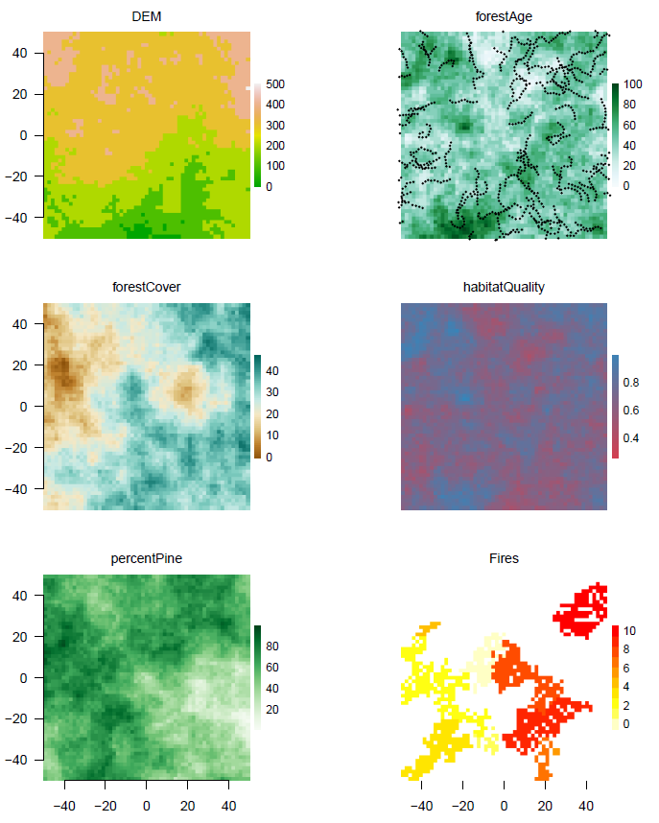
SpaDES: demo 1
Maps:
Digital elevation model
Forest age
Forest cover
Caribou habitat quality
Percent pine
Current fire locations
Caribou movement trajectories plotted on forest age map
Notes:
RandomLandscapes
CaribouMovement
FireSpread

Slide 17
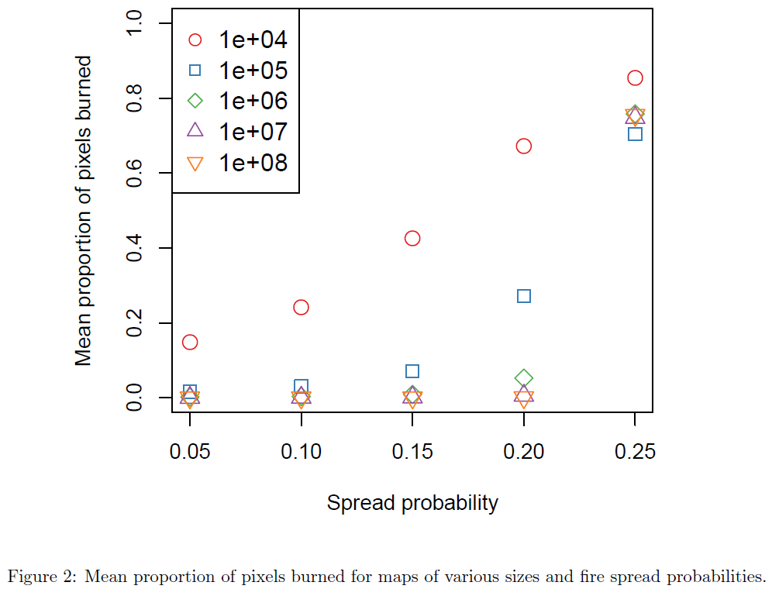
SpaDES: demo 1 (statistics)

Slide 18
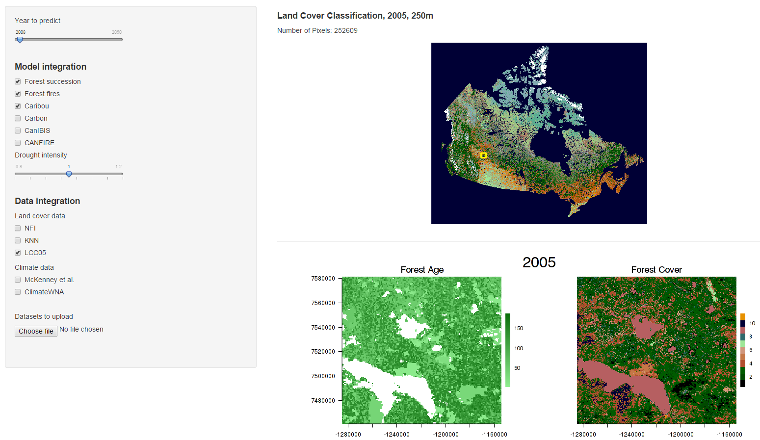
SpaDES: shiny demo 2
Notes:
caribouMovementLcc
fireSpreadLcc
forestAge
forestSuccession

Slide 19
Current active developers
Alex Chubaty
Eliot McIntire
Steve Cumming

Slide 20
Module collaborators
Mountain pine beetle dispersal
Alex Chubaty (PFC/Laval)
Fire spread
Steve Cumming (Laval)
Boreal forest succession and regeneration
Yong Luo (PFC/fRI/Laval)
Caribou movement and habitat use
Sarah Bauduin (Laval)

Slide 21
Planned collaborators
CFS:
Carbon Accounting Team
Assistant Deputy Minister Innovation Fund & ISA
Boisvenue, Shaw, Cooke, Campbell,
Private sector:
Colin Daniel (ApexRMS)
Foothills Research Institute (Healthy Landscapes)
University:
UBC - Nicholas Coops, Val Lemay

Slide 22
Research collaborators
Eliot McIntire (PFC/Laval)
Jill Johnstone (Sask)
David Andison (fRI)

Slide 23
Interested in seeing more?
https://github.com/achubaty/SpaDES
Still a work in progress, BUT…
Current development version (0.5.0)
Almost ready for CRAN!
We welcome feedback
Looking for contributions

Slide 24
Contributions needed
1/2
Additional modules
MPB, Fire, Succession, Caribou
New modules
Spruce Budworm, Carbon, …
Policy
Risk, Economic forecasts, Planning

Slide 25
Contributions needed
2/2
Improving
Dependency expressions
Module, data, spatial region, political region
Big data seamlessness :
R can handle BIG, but many ways to do it;
What’s best for each module/situation?

Slide 26
Thank you!

